Slide 1
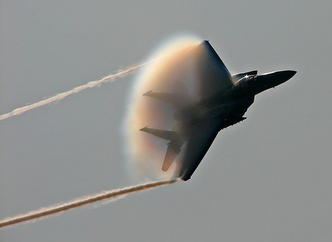
Newton’s Second Law of Motion
This lesson will introduce you to the second of three laws of
dynamics
These laws are the fundamental laws of Dynamics. With them, you
can predict how an object will move when under the influence of
forces.

Slide 2
Learning Goals
By the end of this lesson, you will be able to:
explain the relationship between force, mass, and acceleration
state and explain Newton’s 2nd Law of Motion
identify when the 2nd law applies in certain situation
solve problems involving the 2nd law

Slide 3
Success Criteria
Can I:
state and explain Newton’s 2nd Law
explain situations involving the 2nd law
apply the 2nd law to draw FBD’s and solve for the net force and acceleration of an object.

Slide 4
Force, mass, and acceleration
Newton discovered that a net force can cause an
acceleration
This acceleration is:
- directly prop to the force
- inversely prop to the mass

Slide 5
Newton’s 2nd Law of Motion
The acceleration of an object depends inversely on its mass and directly on the unbalanced force
Newton’s 2nd law of motion tells us that an external
unbalanced force is needed in order to cause
acceleration
the acceleration depends on the mass and the
amount of force

Slide 6
Sample Problem
During a turn in a formula 1 race, drivers experience accelerations of 4.5 g’s (1 g = 9.8 m/s²). Find the magnitude of the net force acting on a driver of mass 65 kg.
Sol’n
∴ the net force on the driver is 2900 N

Slide 7
Sample Problem
A skydiver is jumping out of an airplane. The moment she leaves the plane the parachute is unopened and the air resistance is 291 N. The accel of the skydiver at this instant is 5.96 m/s² [D]. What is her mass?
Sol’n
F_{air}
Next draw a FBD
m
[D] is +’ve
F_{g}

Slide 8
Now we write our F_{net} statement
But, according to the 2nd law F_{net} = ma
∴ the mass of the skydiver is 75.8 kg

Slide 9
PRACTICE Problem
1. Which of the following describes Newton’s Second Law of Motion?
a α F_{net} and a α m
a α 1/F_{net} and a α m
a α F_{net} and a α 1/m
a α 1/F_{net} and a α 1/m
a α F_{net} only

Slide 10
PRACTICE Problem
2. If the net force on an object doubled but the mass remained the same, then what would happen to the accel?
quarter
half
remain the same
double
quadruple

Slide 11
PRACTICE Problem
3. If the mass on an object doubled but the net force remained the same, then what would happen to the accel?
quarter
half
remain the same
double
quadruple

Slide 12
PRACTICE Problem
4. If the mass on an object doubled and the net force was halved, then what would happen to the accel?
quarter
half
remain the same
double
quadruple

Slide 13
PRACTICE Problem
5. If the mass on an object halved and the net force was doubled, then what would happen to the accel?
quarter
half
remain the same
double
quadruple

Slide 14
PRACTICE Problem
6. What is the net force acting on a 12 kg mass accelerating at 6.0 m/s²?

Slide 15
PRACTICE Problem
7. The highest known acceleration voluntarily encountered by a human is 45 g’s. What net force would a human of mass 70 kg experience at this acceleration?

Slide 16
PRACTICE Problem
8. A net force of 2000. N [F] acts on car of mass 1500 kg. What is the acceleration of the car?

Slide 17
HOMEWORK
Read Section 3.3
Review Tutorial 1 and 2
Questions 1 – 6 pg 133
1 – 2 pg 135
4 – 8 pg 136

